Slide 1

Error Proofing
Lean Six Sigma

Slide 2
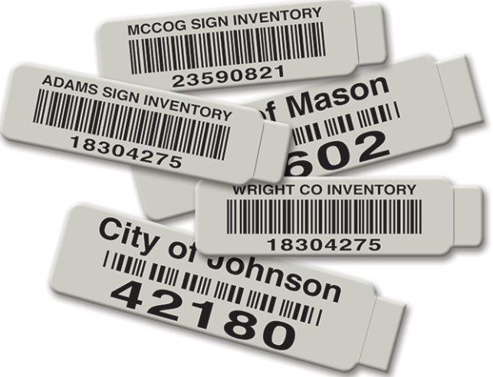
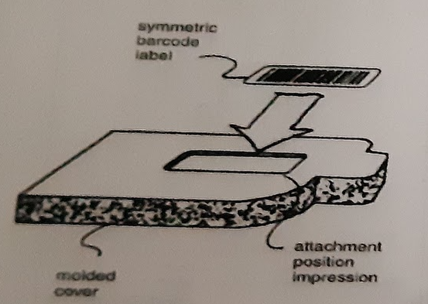
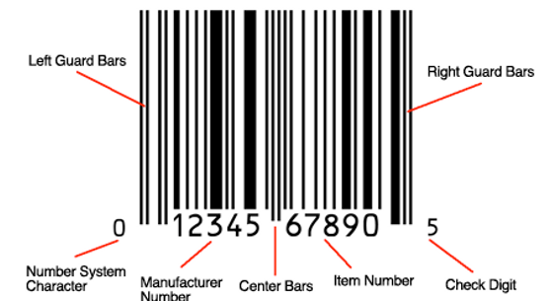
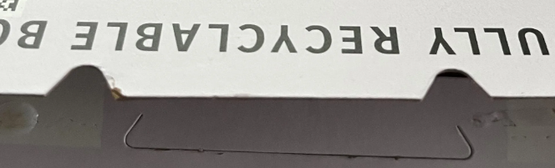
Description of Problem: The barcode is installed upside down, causing issues.
Before Improvement
It is difficult to see at a glance whether or not a barcode is upside down. This is particularly true when the barcode label does not have any letters or numbers. Some labels are installed upside down.
Barcode Design Improvements:
Unique Shape: Design the barcode label with a unique shape (e.g., asymmetrical, with cutouts) that only fits correctly in one orientation within the molded cover.
Automation:
Implement automated label installation processes to improve accuracy and consistency.
Utilize automated barcode readers to check label placement and orientation immediately after installation.
Reject products where the barcode cannot be read by the machine.
Numbering System: Add unique numbers or alphanumeric codes to each barcode. This allows for verification of correct barcode placement and identification of any potential issues.

Slide 3
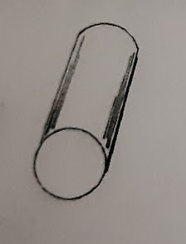
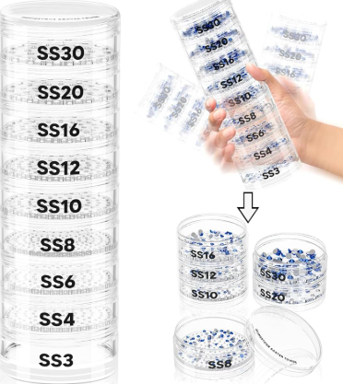
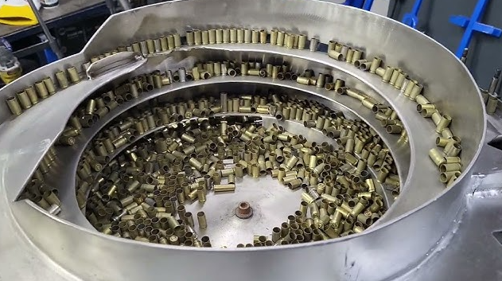
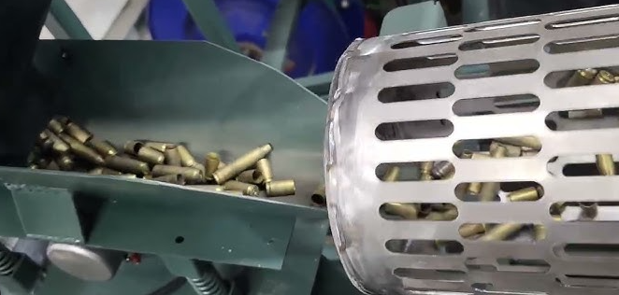
Description of Problem: Drive pins are processed in a high-volume manufacturing process.
Description of Problem: Drive pins are processed in a high-volume manufacturing process.
Before Improvement Occasionally the equipment is adjusted incorrectly, and pins of the wrong diameter are produced. When this happens, numerous bad parts are produced before the problem is detected. In addition, pins of the wrong diameter from the previous batch sometimes get mixed with good parts.
When customers try to use drive pins that are too large, they can damage expensive products. If the pins are too small, they may wear too quickly or fall out, causing safety problems or product failures.
Improved Solution: Two-Stage Filtering System
Oversized Pin Rejection:
Filter System: Implement a filter system with precisely sized openings. Pins with diameters larger than the specified tolerance will be physically blocked from passing through.
Rejection: Rejected oversized pins can be collected separately for potential rework or recycling.
Undersized Pin Rejection:
Filter System: Use a second stage with a slightly narrower opening. Pins that are within the acceptable tolerance range will pass through both filters. However, undersized pins will pass through the first filter but be blocked by the second.
Rejection: Undersized pins are collected separately for rework or disposal.

Slide 4
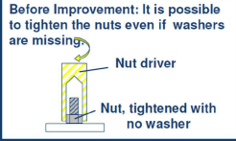
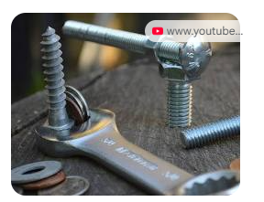
Problem: Washers left out before Tightening Description of Problem: Operator adds washer and nut, then tightens using an automatic nut driver
1. Preventative Measures:
Visual Aids & Checklists: Use visual cues and checklists to remind operators.
Pokayoke Devices: Implement mechanisms that physically prevent tightening without a washer (e.g., sensors, interlocks, automated washer feeders).
Training & Standardization: Train operators and enforce clear, standardized work instructions.
2. Detective Measures:
Automated Inspection: Use vision systems or sensors to detect missing washers.
Audits & Self-Checks: Conduct regular inspections and encourage operators to self-check.
3. Additional Considerations:
Root Cause Analysis: Investigate underlying reasons for the error (e.g., ergonomic issues, time pressure).
Cost-Benefit Analysis: Evaluate the cost-effectiveness of each solution.

Slide 5
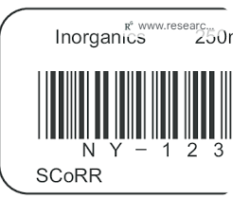

Description of Problem: Wrong samples sent to a wrong department.
SOLUTIONS:
1. Improve Identification & Tracking:
Unique IDs, color-coded labels, barcodes.
2. Standardize Procedures:
SOPs, checklists.
3. Enhance Visual Guidance:
Clear signage, visual aids like flowcharts.
4. Utilize Technology:
Sample tracking software, automated routing systems.
5. Train Personnel:
Regular training, emphasizing accuracy.
6. Root Cause Analysis & Corrective Actions:
Investigate errors, implement corrective actions
Before improvement: Samples that were supposed to be sent to Bioprocessings were sent to MSAT.

Slide 6
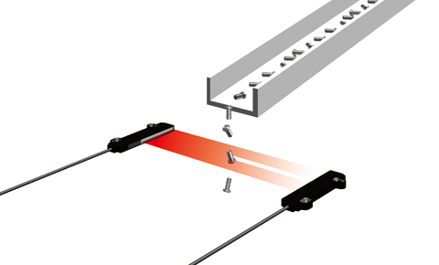
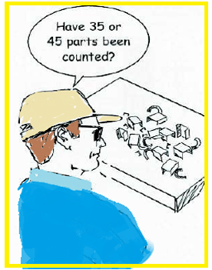
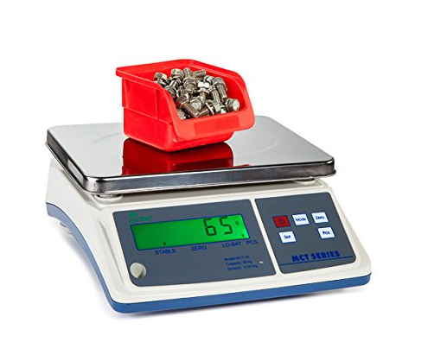
Description of Problem: Operators must count out a number of small parts for packaging and shipment
AFTER IMPROVEMENT
a)Placing sensors on production line that will count each part as it passes on the conveyer
b)Providing a weight scale to display exact weight of the container. Scale is calibrated precisely so can differentiate if one piece is missing or is too many.
Before improvement: Operators make many counting errors. It is very difficult to recognize if a counting error has occurred

Slide 7
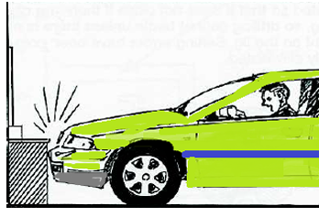
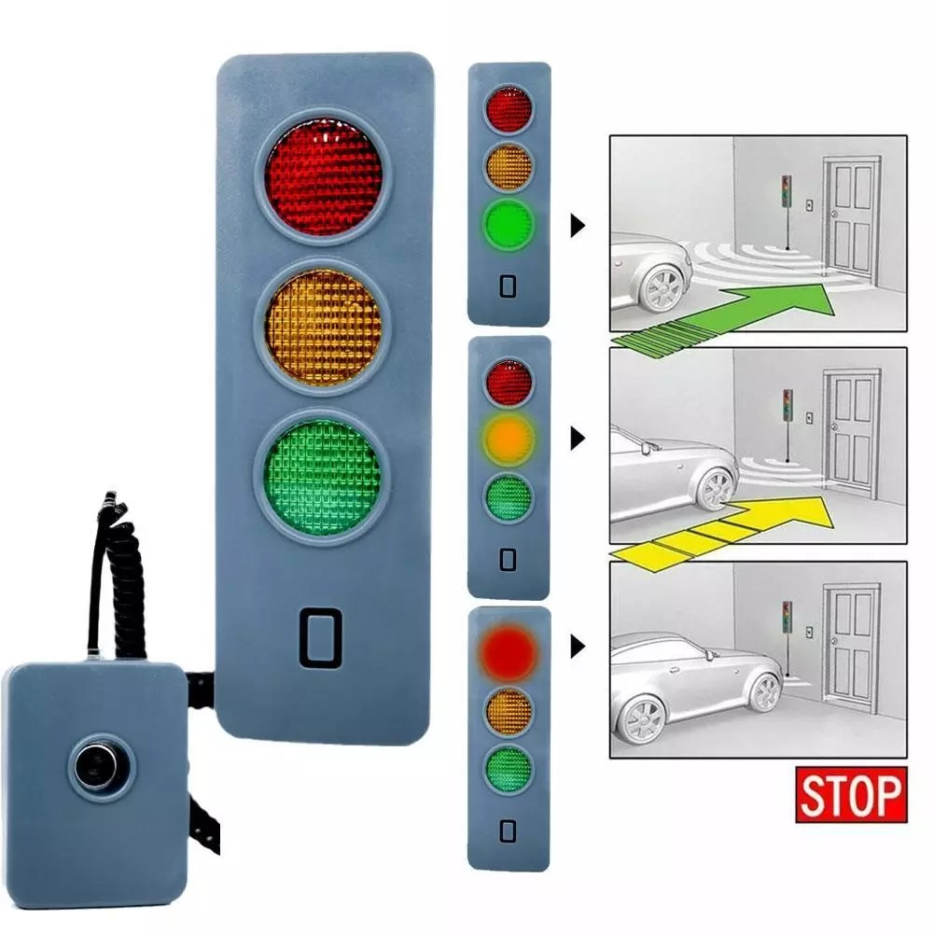
Description of Problem: Vehicles are parked in the garage after an excursion
After Improvement Install proximity sensor at each parking space with light indicator which driver can see. These sensors detect the distance between the car and walls reduce chance of bumps. Light indicator is placed in visible location to guide driver how far to pull in. This method will ensure that vehicle is parked in right position preventing damage to car, wall or garage doors.
Before improvement: The available parking space may be limited, requiring accurate positioning of the vehicle. With the sloping hood of the vehicle, it is difficult to accurately judge the position of the bumpers. Drivers may bump into walls or cabinets if they pull in too far, or the garage door may hit the car if they do not pull in far enough

